Slide 1
CORAL
A Real-time Sentry for the World’s Oceans
Developed by Joseph Farah in Python
jrfarah.github.io/coral
Notes:
CHECKLIST
-Fast internet connection!
-WEBSITE OPEN!
-Open command prompt in the coral/src/ directory!
-Sublime text open to show the code quickly!
-Test the software at least twice beforehand!

Slide 2
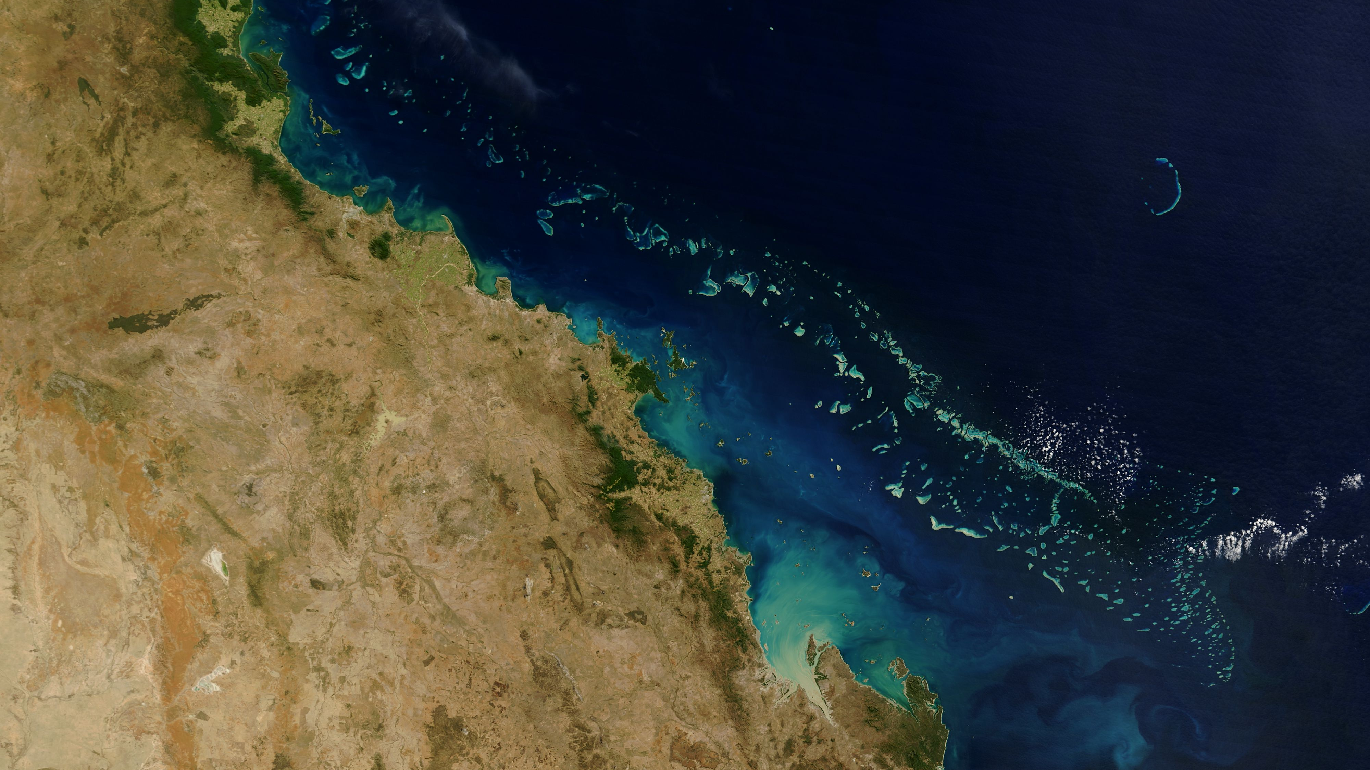
What are coral?
Living creature
25% of marine life
Evolution
Sources of medicines and disease treatments
Notes:
A living creature—thousands of colonies of tiny coral polyps calcifying limestone to form hard outer shells, closely related to jellyfish
Home to 25% of the world’s marine life
Helps direct the course of evolution in the ocean—species can only survive on certain coral colors/compositions, meaning if you destroy the corals you destroy the animals that call them home
Coral reef plants and animals are important sources of new medicines being developed to treat cancer, arthritis, human bacterial infections, Alzheimer’s disease, heart disease, viruses, and other diseases. (Source: NOAA)

Slide 3
The reefs are dying.
Ocean = giant calorimeter
pH reliance
1% coverage = 25% of marine life
2/3 of reefs threatened by human activity
Total bleaching
Notes:
93% of climate change heat is absorbed by the ocean—the ocean is a giant calorimeter, meaning it absorbs heat quite well. Water is often used as a standard to measure energy output because it is so good at absorbing ambient heat
Coral reefs require specific pH ranges—outside of these ranges, they will be poisoned. As the temperature of water changes, so does its pH.
Support 25% of all marine life, despite covering only 1% of the ocean floor. This is due to the fact that they stretch upwards significantly and also group together over great swathes of the ocean floor, which is conducive for ocean life
60% of the world’s reefs are threatened by human activity—destructive fishing (dynamite, cyanide), careless tourism, pollution, coral mining, sedimentation/erosion, climate change
99% of the world’s reefs are projected to experience bleaching in the next few decades

Slide 4
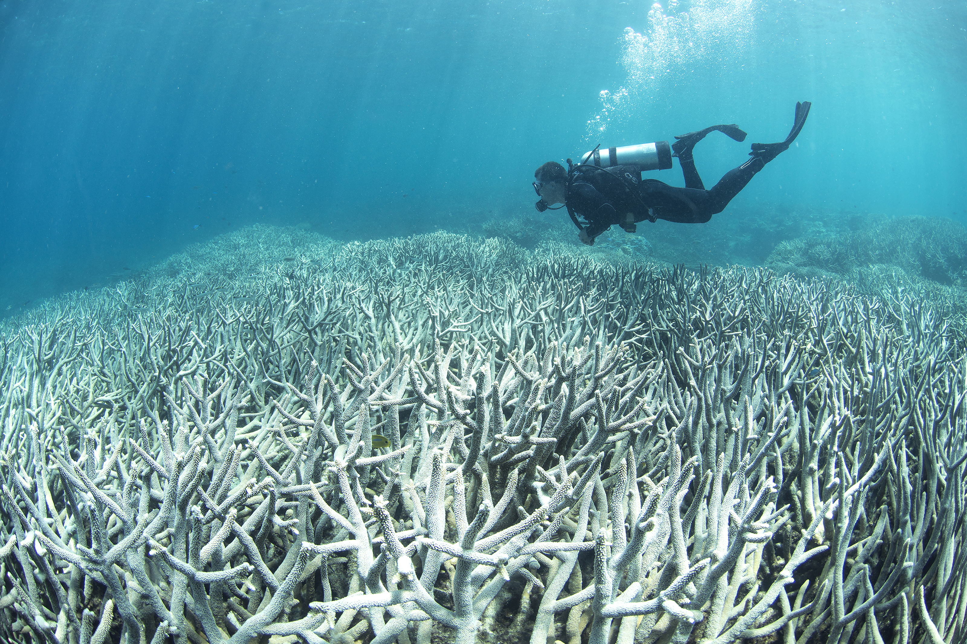
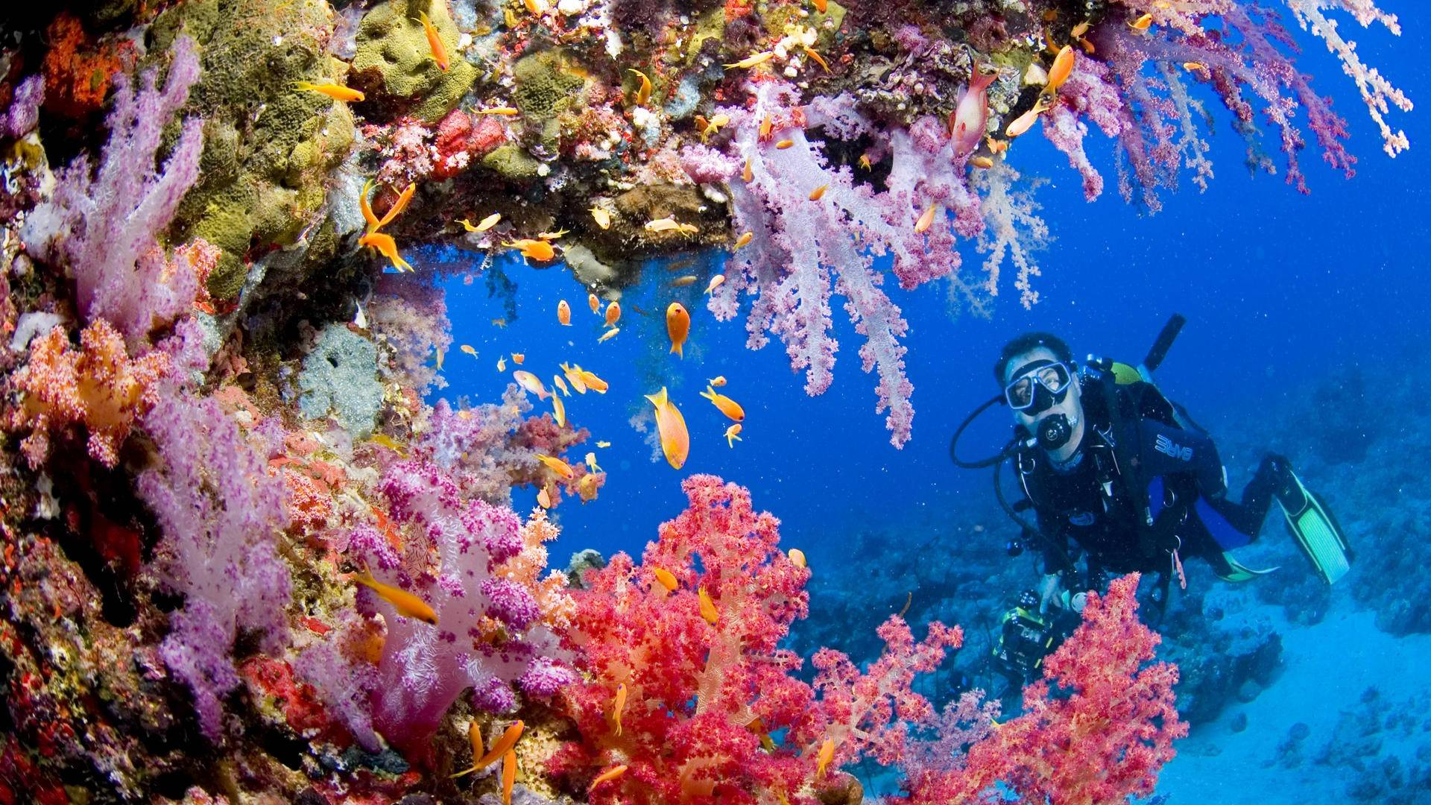

Slide 5
What is CORAL?
Central data hub
Scientific monitoring tool
Interactive and engaging
Continuously monitoring
Rapid response plan trigger
Notes:
A central hub for real-time data from the National Oceanic and Atmospheric Administration
A tool for scientists to monitor reef stress around the world and compare world conditions to world bleaching percentages
An interactive and engaging way to encourage interest in protecting one of Earth’s most important and beautiful resources
Continuous monitoring of sea surface temperature at global scales provides researchers and stakeholders with tools to understand and better manage the complex interactions leading to coral bleaching. When bleaching conditions occur, these tools can be used to trigger bleaching response plans and support appropriate management decisions.

Slide 6
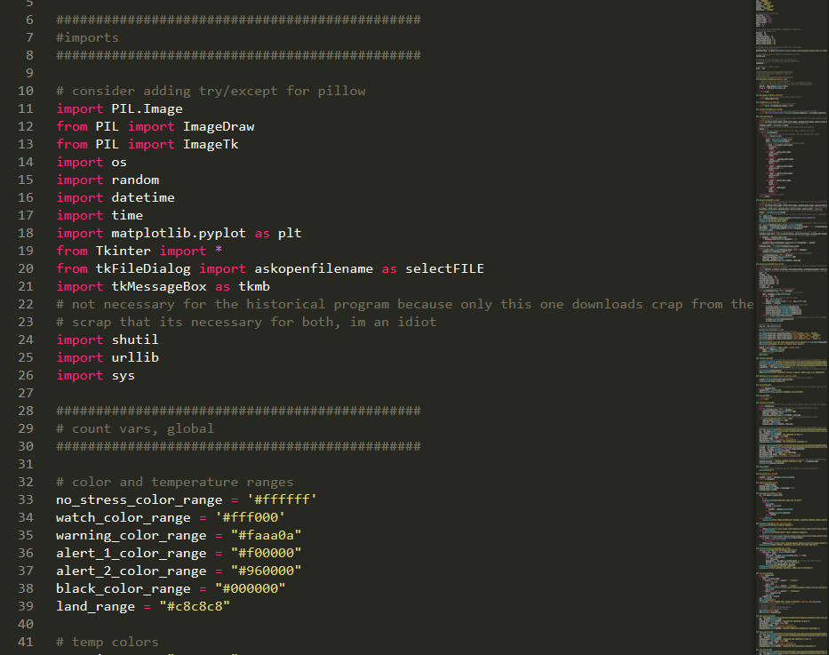
Built from the ground up with Python2.7
Modules used:
PIL (Python Image Library)
MATPLOTLIB and PyRoot Tkinter
Urllib/BeautifulSoup
Why Python?
Versatile
Easy GUI framework
Expandable
Friendly to newcomers
Notes:
Coded 100% in Python
Modules used:
PIL (Python Image Library) for analysis of NOAA maps, which are of reasonable size but low complexity
MATPLOTLIB and PyRoot for graphing—PyRoot is developed by CERN for particle physics research and thus is quite adept at handling massive datasets in realtime
Tkinter for GUI interactions—easy but versatile
Urllib/BeautifulSoup for image and information scraping from various webpages, mostly NOAA and NASA
Why Python?
Extremely versatile, with many premade libraries and modules. Easy custom dataset integration. Dynamic variable typing
Easy GUI framework—Tkinter
Easier to allow newcomers to create additional functions for the software (due to readability of existing code)

Slide 7
A hub, a tool, an engager
CORAL is many things

Slide 8
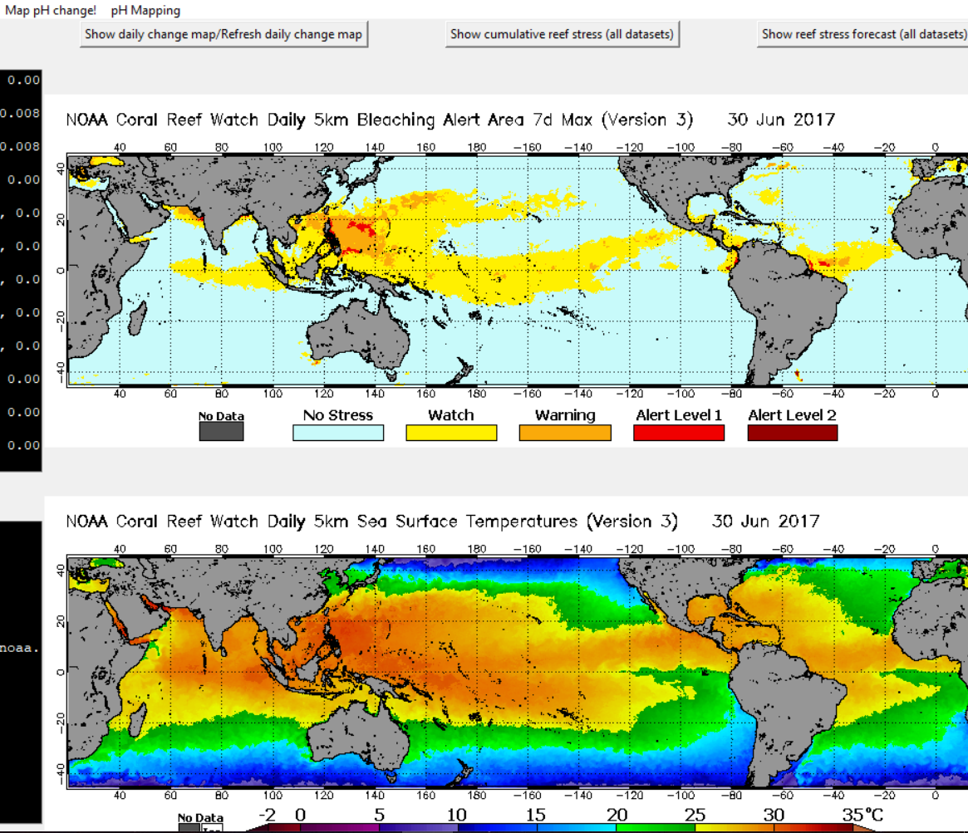
Central Hub for NOAA
Constant NOAA datastreams
Various sources—land, sea, and sky
Central map access
Accessible and understandable
Useful for laymen and scientists
Notes:
Every day the NOAA puts out datasets and maps
Gathered from satellites, boats, and ground monitoring stations
Also in collaboration with NASA’s GFS and EarthWatch systems
CORAL groups all these maps in one location
Provides easy accessibility and interpretation
Colorful and easy-to-read maps are useful for interested parties and scientists alike

Slide 9
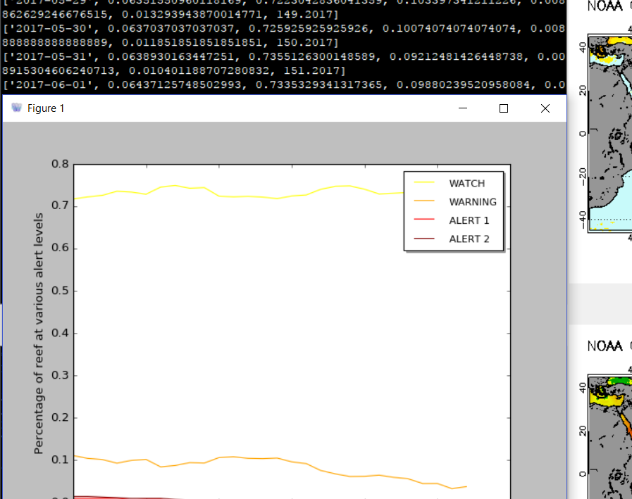
A Tool for Scientists
Keeps track of EVERYTHING
Percentages
Estimations/predictions
temperatures
Graphs all over time
Comparison tools
Under development
Notes:
Keeps track of EVERYTHING
Percentage of coral reef bleaching worldwide
Percentage of coral reefs worldwide on bleaching alert status
Estimations of pH in 50kmx50km strips of ocean
Ocean temperatures
Graphs all over time
Provides integrated tools to compare any variable to the other and manipulate the datasets in anyway (with the exception of changing the contents)
This feature will be constantly under development as more and more information comes in from the NOAA

Slide 10
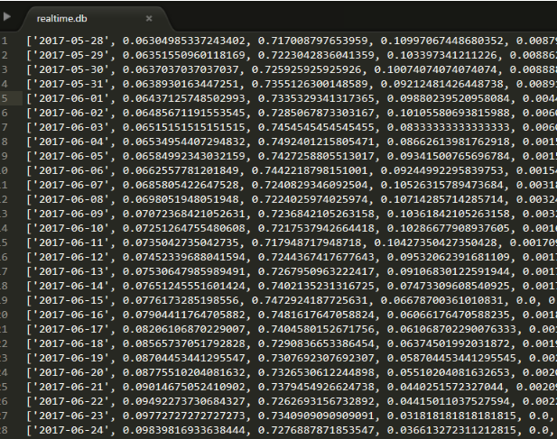
Dataset formatting
General organizations:
[individual, (data, bunches), identifier]
Individual
Timestamp from program analysis
Data bunches
Decimals representing percentages
Identifier
When did the NOAA gather the data?
Notes:
Datasets are organized like thus:
[individual, (data, bunches), identifier]
Individual
The timestamp that the program analyzed the data, this gives each element in the dataset a unique attribute and helps protect against confusing Python list methods
Data bunches
The data is stored in the middle section, usually as decimals representing some sort of percentage
Identifier
The program’s estimation of the date the NOAA gathered the data, in the form of (day_of_the_year.year) ex: 167.2017

Slide 11
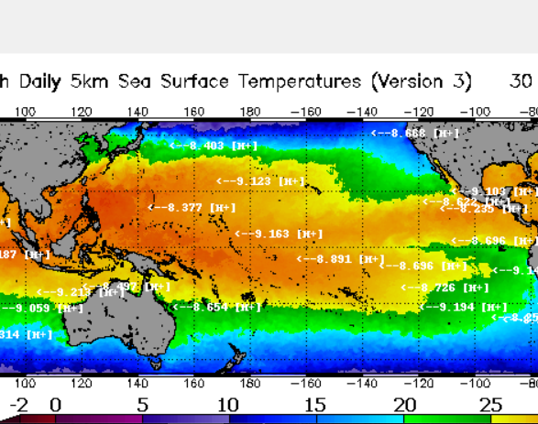
An engager for laymen
Variety of data/stats
Do you want to learn more about reef-bleaching?
Less data-raw
Contribute
Future with data-syncing
Thousands of participants
Notes:
Also provides less-scientifically-important data and statistics
Not for studies but to engage people who download the program to learn more about reef bleaching
Non-scientists will also be kept update on global ocean CO2 ppm, pH flux, bleaching percentages, etc, but in a less data raw format
Provides opportunity for interested people to contribute
In the future, CORAL will be able to sync datasets from thousands of computers to provide millions of data points for scientists regarding temperature/pH changes vs bleaching all around the world, something no single computer can accomplish

Slide 12
Where to go from here?
Easier correlation interface
Master dataset
Better integration with pyROOT
On-tap map explanations
Machine–learning and TensorFlow == better predictions
Improve UI
Tkinter isn’t the best
Notes:
Easier interface to graph multiple variables side-by-side
Integration of thousands of pH data points into one master dataset
Better integration with pyROOT
Provide on-tap explanations for maps
Use machine–learning and TensorFlow to improve predictions of coral reef bleaching
Improve UI
UI sometimes realigns when new maps are loaded

Slide 13
And now, for a live demo

